Slide 1
Hertfordshire Valuing SEND Training
Schools and Settings
Summer Term 2023
Notes:
Holding screen

Slide 2



Grounds Rules for our Virtual Training
As this is a virtual workshop, we would like to agree a number of ground rules:
  Keep your microphone muted when you are not talking but we would love to see faces so those who can keep cameras on please do so;
  If you would like to ask questions during the presentation please use the raise hand function or add them into the chat;
  Stay focused and engaged on the workshop – resisting the temptation to check emails or the news;
  We want to hear from you! - This is a safe space to test your thinking and share ideas around Valuing SEND with peers.
You can type questions into the chat box as we go along, and we will monitor this where possible to quickly answer short questions throughout the session
We will stop for a Q&A session after demonstrating the tool itself to you, when we will answer any longer questions – we will do this via hands up and microphones for efficiency
Notes:
SENDIAGO (Katy/Latoya/Sarah/Su)

Slide 3
Objectives for today’s training
To introduce you to the Valuing SEND approach, its purpose and its use in supporting settings and children with SEND in Hertfordshire
To provide an opportunity to see the tool in action and familiarise yourself with how it works in practice
To gain a detailed understanding that enables you to Introduce the Valuing SEND approach to your setting and processes
Notes:
SENDIAGO (Katy/Latoya/Sarah/Su)

Slide 4




Valuing SEND | Transformation overview
As part of the SEND Transformation happening in Hertfordshire, 4 successful trials of Valuing SEND were undertaken with pilot settings and this is the final phase of the county-wide roll out of the new approach.
The shared ambition for Valuing SEND is to:
Improve children’s long-term outcomes and inclusion
Improve the experience of families and professionals across the system.
Valuing SEND aims to achieve this by:
Developing a single, rounded picture of the needs of children and the support they need to succeed and prosper within and outside of their education - from birth to adulthood (across early years, primary, secondary, special and post 16 education).
Using this as the foundation for planning and commissioning of support, monitoring of progress and evaluation of support at a child and cohort level, and to enable earlier and more co-ordinated intervention.
Notes:
SENDIAGO (Katy/Latoya/Sarah/Su)

Slide 5
Valuing SEND | The vision
Mainstream settings are rapidly improving inclusive practice and meeting more need, both in Hertfordshire and nationally
Increase the knowledge base at the chalkface using the “Support Planning” section of the VSEND tool
SLT/SENCO can use VSEND to identify specific areas of CPD needed among staff, and can feed into existing coaching and mentoring structures within settings
There is a greater need within mainstream settings due to better and earlier identification, post-pandemic impact and other factors
Improved efficiency for the SENCO role
More efficient discussions amongst professionals, enabling swifter implementation of provision as the approach is increasingly embedded
Use of VSEND alongside Descriptors of Need (provision document) by all staff involved in a CYP’s provision
Maintaining the heart of the process: keeping CYP and their family at the centre of tracking and provision
Enhanced discussion with families using the “Home Confidence” section of the tool, placing equal importance upon provision within the home as that at the setting
Any and all staff can use VSEND* to consider a CYP’s needs – not just the highly-skilled SENCO
All staff can be given access to VSEND*, enabling them to independently seek and implement appropriate strategies according to need
Challenge in creating a consistent approach to evidence-based applications across Hertfordshire (and nationally)
Provides a free visual tracking tool that can sit at the centre of a CYP’s file of evidence
Enables SENCOs (and other staff) to clearly evidence need in discussion with parents, where professional judgement deems this appropriate
Supports multi-disciplinary interventions and partnership work with Health and Social Care
Notes:
SENDIAGO (Katy/Latoya/Sarah/Su)
Challenges on the left
Ways in which VSEND can contribute to solution-focused working on the right
Always welcome feedback, analysis and thoughts

Slide 6

Introduction to Valuing SEND
We will stop for a Q&A session after demonstrating the tool itself to you, when we will answer any longer questions – we will do this via hands up and microphones for efficiency
Notes:
Champion (e.g. DSPL Manager / SEND Lead)

Slide 7
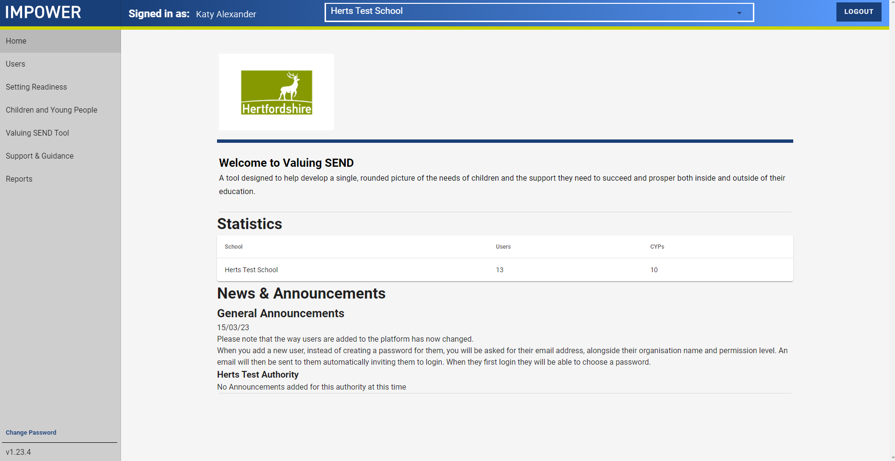
A look at the VSEND tool: homepage
Notes:
SENDIAGO (Katy/Latoya/Sarah/Su)
A look at the tool itself
Note: sign-in requires an authenticator, e.g. Google or Microsoft
Contact Unify for technical queries

Slide 8
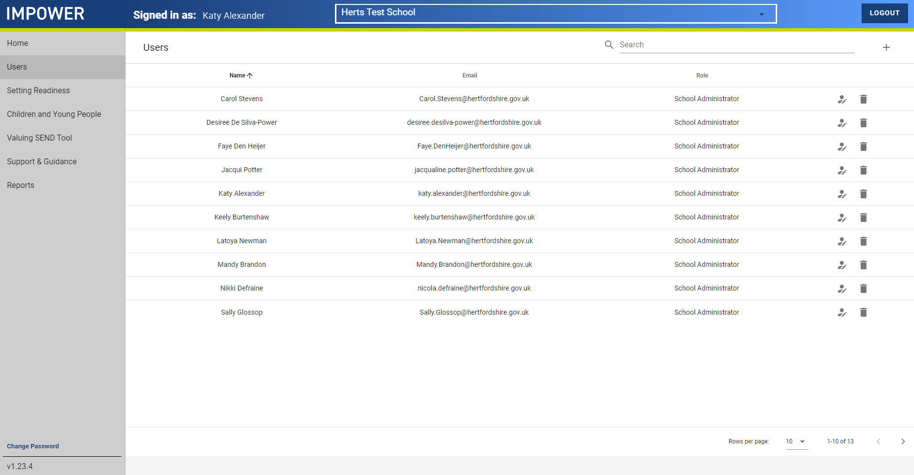
A look at the VSEND tool: users
Everyone will be “School Administrator” as this is the only role needed within settings.
Note that each setting is permitted 1 login each – recommend creating a central “VSEND” logon with a standard password. Follow your GDPR policies!
Notes:
SENDIAGO (Katy/Latoya/Sarah/Su)

Slide 9
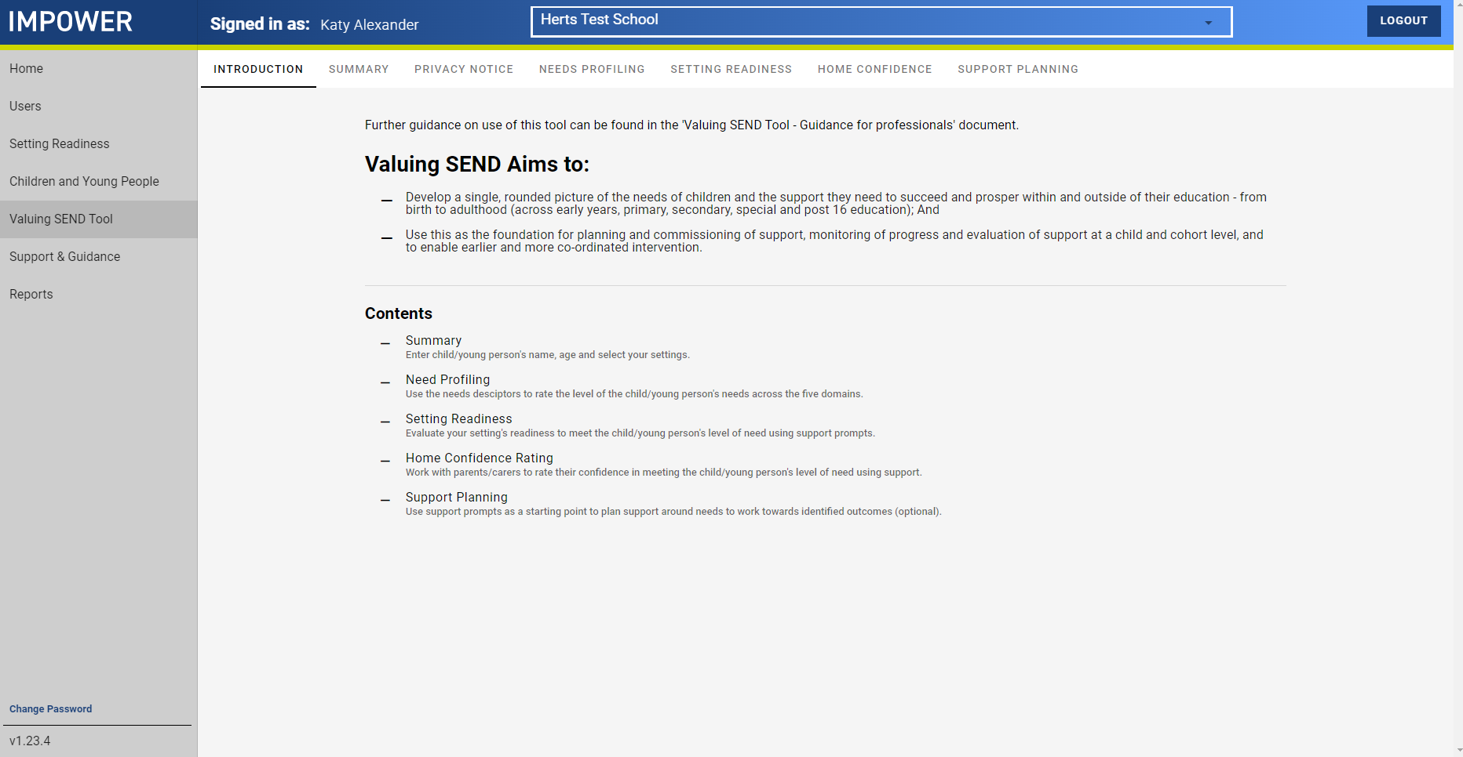





Valuing SEND | Tool completion at a glance
Summary
Setting readiness
Needs descriptors
Home confidence
Support planning
Enter the child/ young person’s details.
Evaluate your setting's readiness to meet this child/ young person's level of need using support prompts. This may be done in collaboration with colleagues
Use the needs descriptors to rate the level of the child/ young person's needs across the five domains
Parent/carer or family evaluates their confidence to meet this child/ young person's level of need at home using support prompts in conversation with practitioner
Use support prompts as a starting point to plan support around needs to work towards identified outcomes
Notes:
SENDIAGO (Katy/Latoya/Sarah/Su)
Look at each stage of the online tool and how to complete it
We will look at each of these in detail through the next part of the presentation, after which we’ll have questions / time for discussion
Setting readiness
Ideally completed with other staff, especially SLT
This is a whole-setting tool: we know SENCOs have high levels of knowledge re: strategies and resources
Done through prompts, best fit approach to decide on a generic rating for your setting
Completed annually
Needs descriptors
The CYP’s needs profile
Can be completed wholly or in part by anyone – in line with good practice, the SENCO should have oversight of all pupils on the SEND register, and teachers should have oversight of all CYP in their class/subject
Done through prompts, which you click and rate the level of need
Brings together all the assessments you’ve completed for a CYP
Home confidence
Holistic approach, keeping families involved in this
Expectation that at some point in the process, maybe annually or termly, a supported conversation around confidence to meet needs
Depends on professional trust so may be approached differently for different CYP
Both Needs descriptors and Home confidence can be done over time, using a variety of approaches – doesn’t need to be done on one day in an interview style!
Support planning
Creates prompts and suggested strategies based on what has been inputted for each CYP
This can be shared with teachers, TAs, families
Can provide a basis for multi-disciplinary discussions, e.g. when calling advice lines or speaking with health professionals

Slide 10
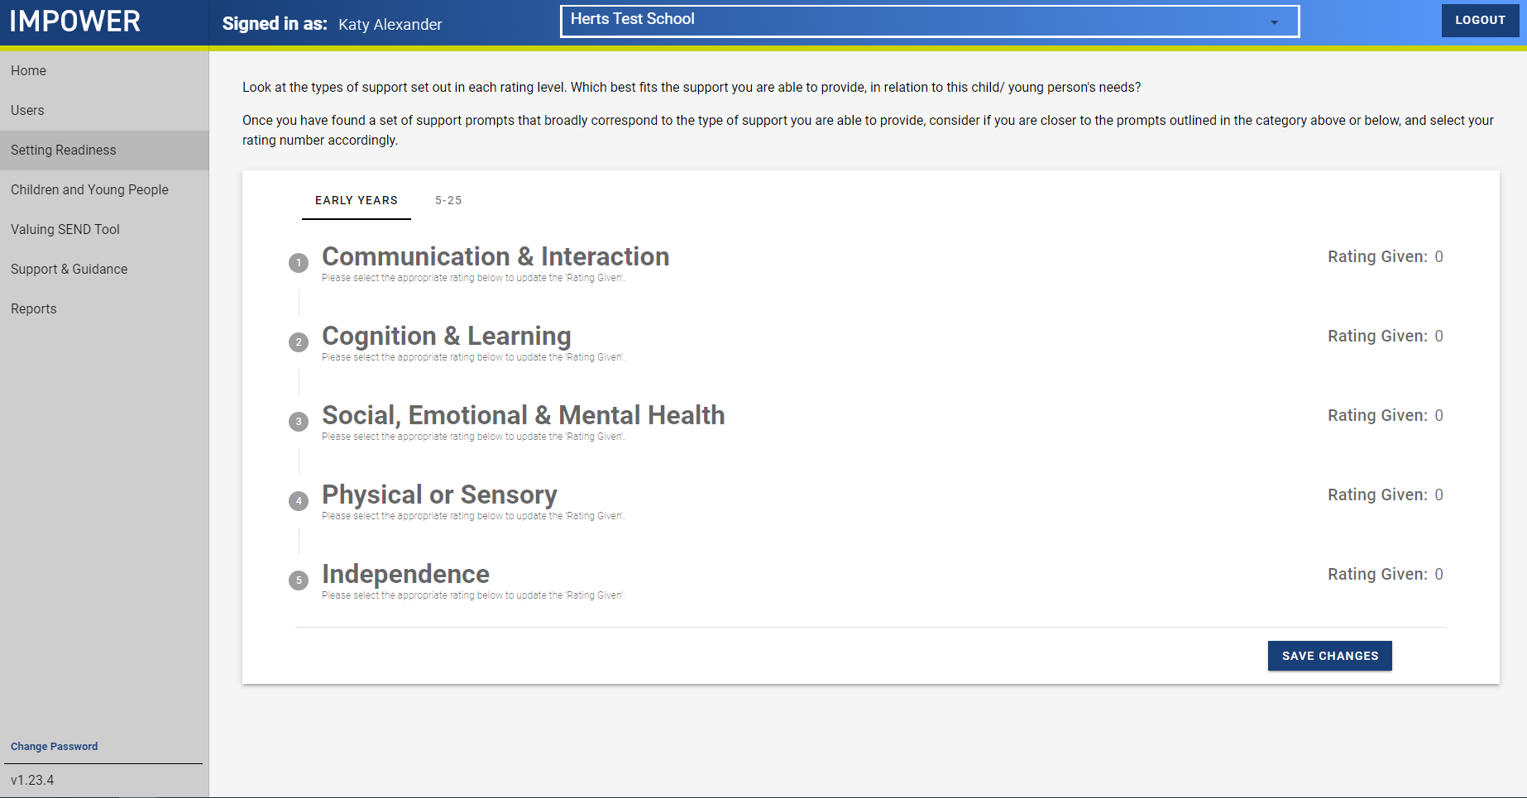
A look at the VSEND tool: Setting Readiness
Split into 5 ‘domains’: the 4 areas of need from the COP, and Independence
Two ‘sides’ to the tool: Early Years and 5-25
Notes:
SENDIAGO (Katy/Latoya/Sarah/Su)
Setting readiness
Ideally completed with other staff, especially SLT
This is a whole-setting tool: we know SENCOs have high levels of knowledge re: strategies and resources
Done through prompts, best fit approach to decide on a generic rating for your setting
Completed annually, or when there are significant changes within your provision

Slide 11
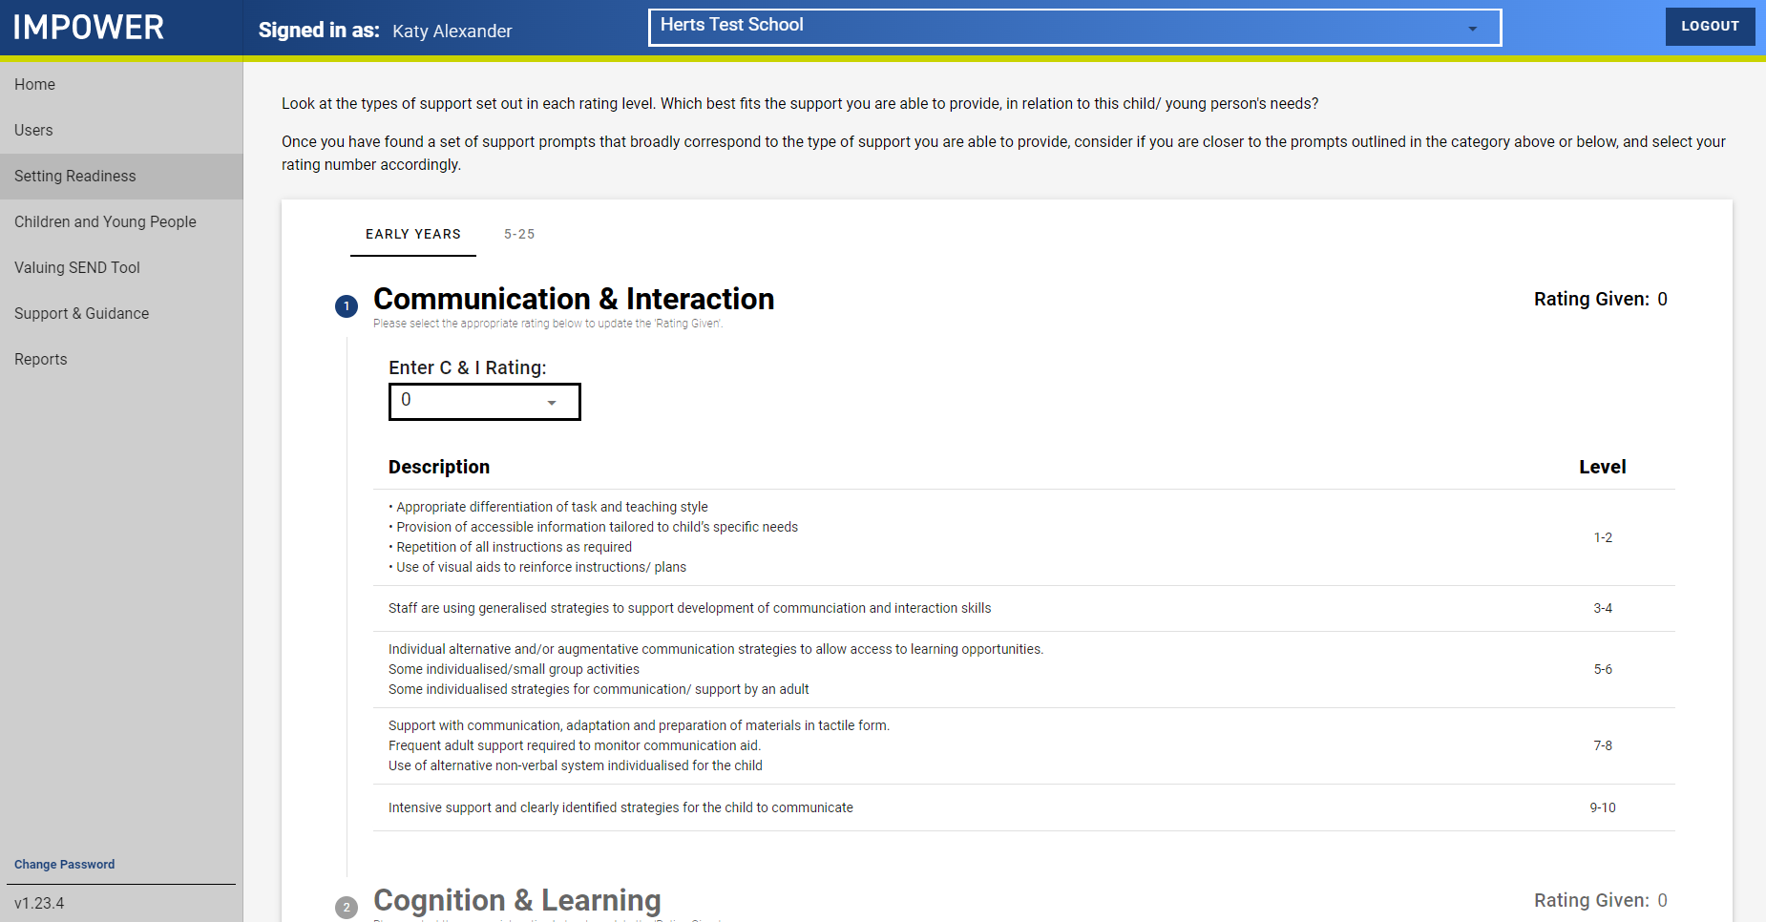
A look at the VSEND tool: Setting Readiness
Click onto the domain title to read the prompts
Each set of prompts correlates to a rating: decide which you think applies to your setting
The ratings are ‘best fit’; each room or situation may be different – we’ll come back to this!
Notes:
SENDIAGO (Katy/Latoya/Sarah/Su)
NB: this is the view of the ‘Early Years’ side of the tool

Slide 12
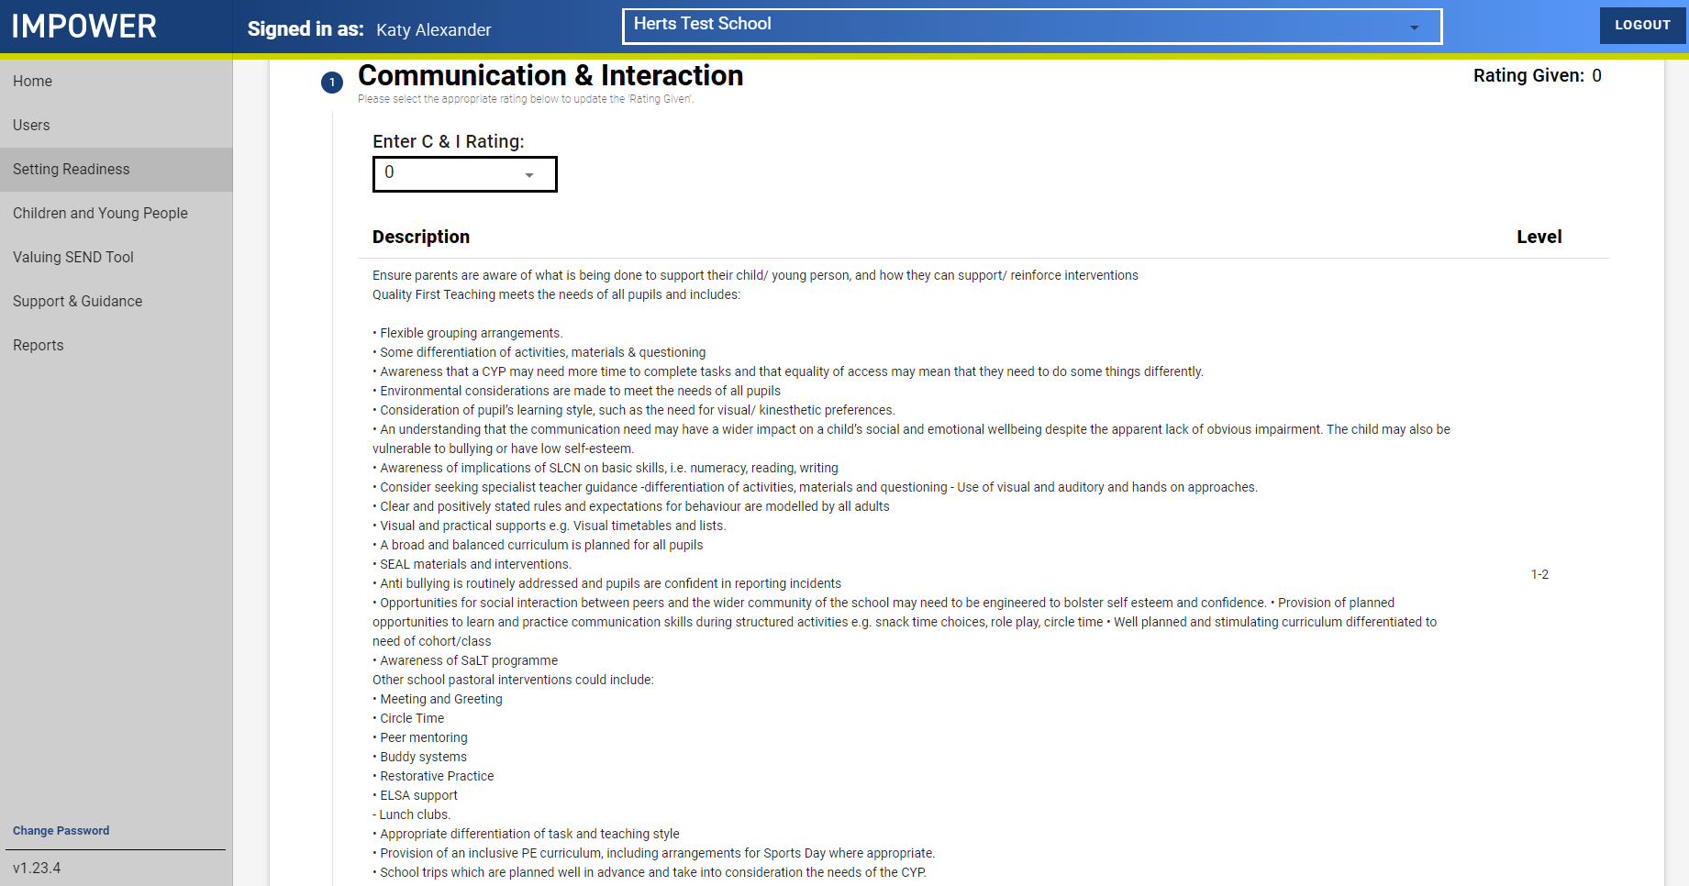
A look at the VSEND tool: Setting Readiness
The prompts on the 5-25 side are much longer!
You may prefer to do this as a paper-based exercise the first time you do it – you’ll be sent printable handouts of the prompts after the training
Note: we are aware of a couple of small errors in the printable handouts and have communicated this with Impower for correction
Notes:
SENDIAGO (Katy/Latoya/Sarah/Su)
NB: this is the view of the 5-25 side of the tool

Slide 13
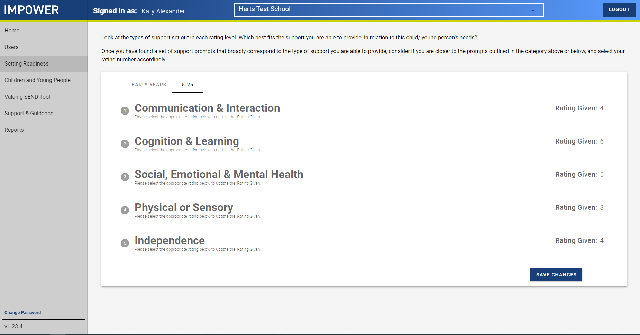
A look at the VSEND tool: Setting Readiness
Mainstream settings are expected to rate themselves between 4 and 6 in each domain, as a rough guide
Remember to click the ‘Save changes’ button!
This data cannot be used to direct admissions; neither the SEND Team nor Admissions Team have access to any of this data
Notes:
SENDIAGO (Katy/Latoya/Sarah/Su)
The point of the tool isn’t to ‘score’ yourself, or to get the highest mark
It’s providing a way of tracking a setting’s own progress within domains, where strengths and areas for development are – you could use this to feed into your CPD planning, the Benchmarking Tool, staff development plan, School Improvement Plan etc
This data can be seen by Local Authority Administrators: that’s the SENDIAGOs and DSPLs, nobody else can see this

Slide 14
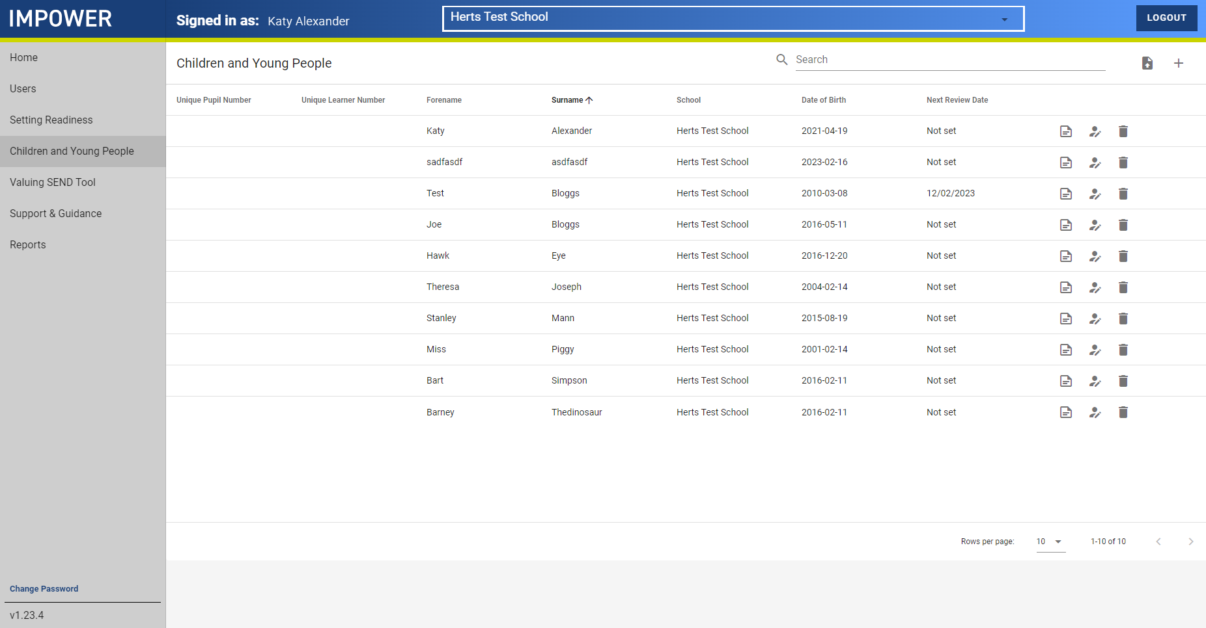
A look at the VSEND tool: CYP profiles
Create a new CYP profile here
An overview of all the CYP for whom there are profiles
CYP data is only accessible by those users who are both registered to the setting and have the setting’s login details
Edit an existing CYP profile here
Notes:
SENDIAGO (Katy/Latoya/Sarah/Su)
Local Authority Administrators can see anonymous aggregated data for a setting, i.e. the average score for all CYP with a profile – there is no way of identifying any individuals
Could ask: how would us seeing this data be useful for you, as settings? What would be most useful for you as an outcome?

Slide 15
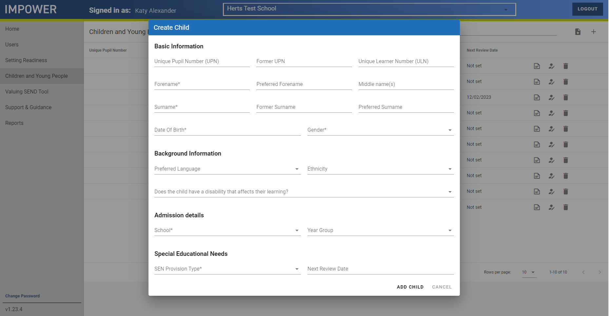
A look at the VSEND tool: CYP profiles
Aim to complete 3 CYP profiles by the end of the year (or at least 1!)
Notes:
SENDIAGO (Katy/Latoya/Sarah/Su)

Slide 16
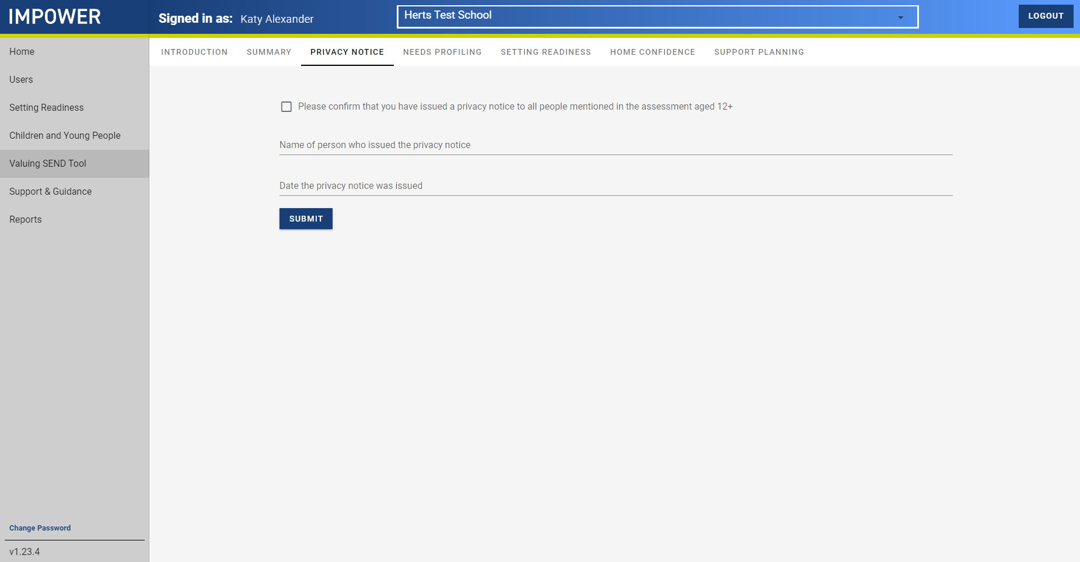
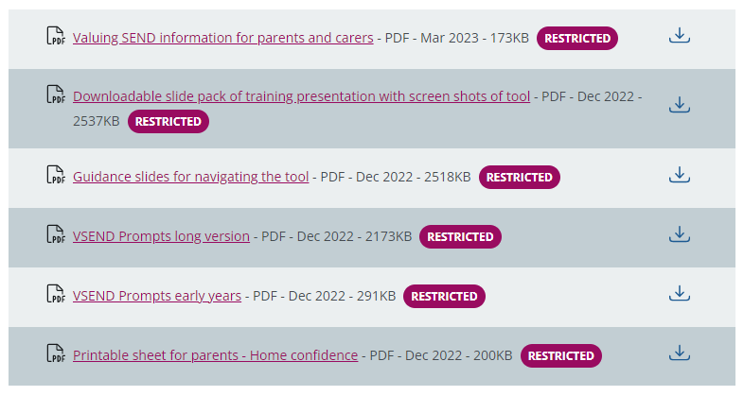
A look at the VSEND tool: CYP profiles
This ties into your existing Acceptable Use Agreement as a setting
On The Grid there is a VSEND advice leaflet for parents
It is assumed that you are discussing any concerns regarding a CYP’s progress with the CYP and/or their family, as appropriate
Notes:
SENDIAGO (Katy/Latoya/Sarah/Su)

Slide 17
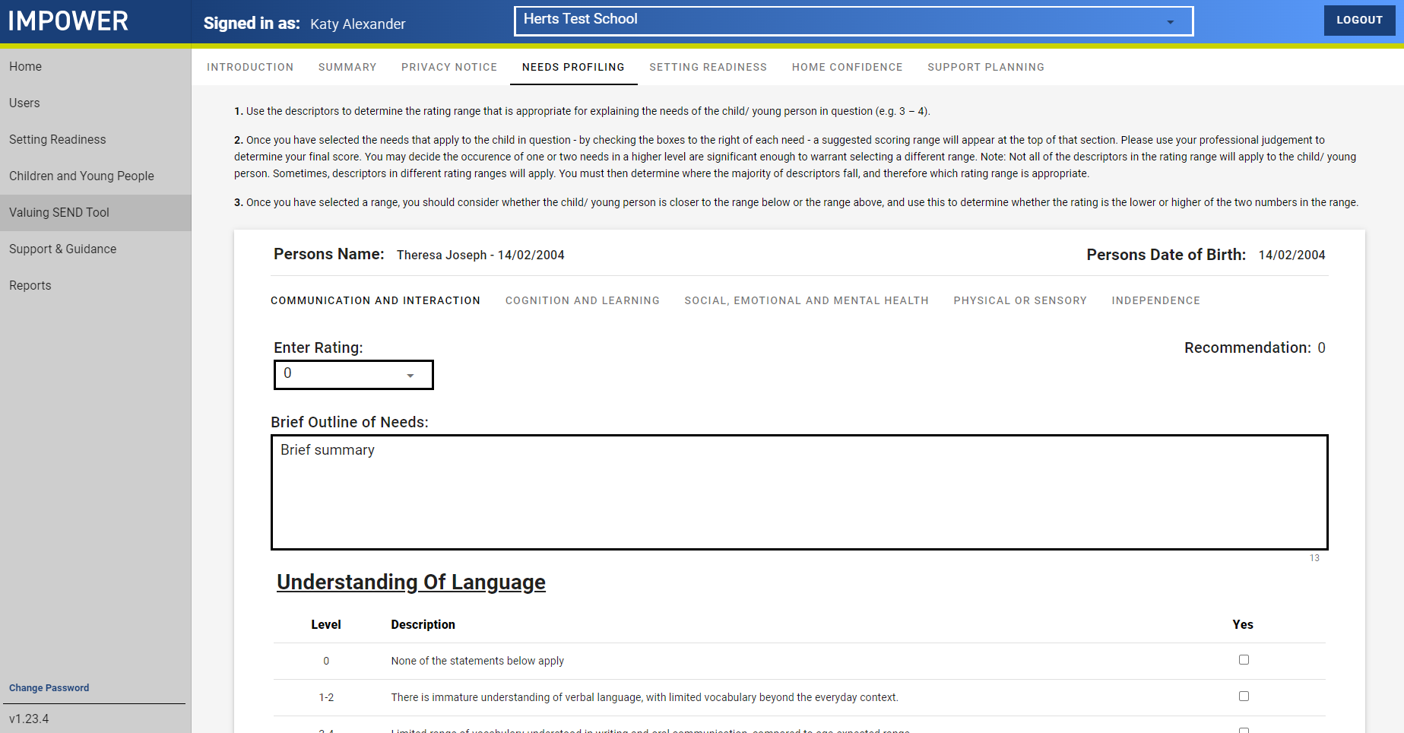
A look at the VSEND tool: CYP profiles
Handy instructions at the top of the page
Click through each of the 5 domains in turn
In this box, you can outline anything relevant to the CYP, e.g. their class has a highly trained SLCN member of staff, as this may not be reflected in the ‘best fit’ Setting Readiness
Notes:
SENDIAGO (Katy/Latoya/Sarah/Su)
Needs descriptors
The CYP’s needs profile
Can be completed wholly or in part by anyone – in line with good practice, the SENCO should have oversight of all pupils on the SEND register, and teachers should have oversight of all CYP in their class/subject
Done through prompts, which you click and rate the level of need
Brings together all the assessments you’ve completed for a CYP

Slide 18
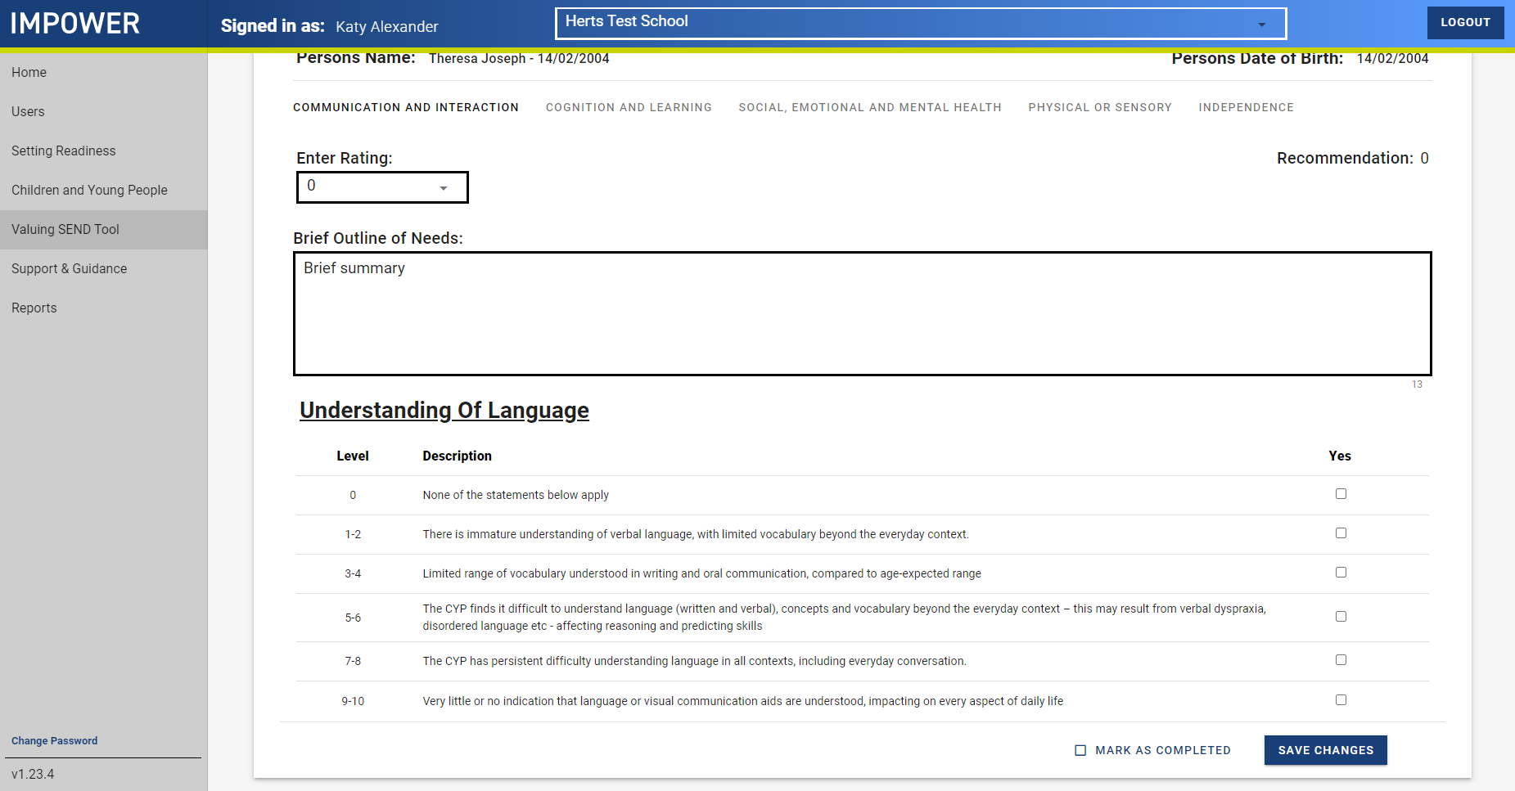
A look at the VSEND tool: CYP profiles
The tool displays one prompt at a time for easy navigation
Read the prompts and decide which most closely resembles the needs with which the CYP presents
Notes:
SENDIAGO (Katy/Latoya/Sarah/Su)

Slide 19
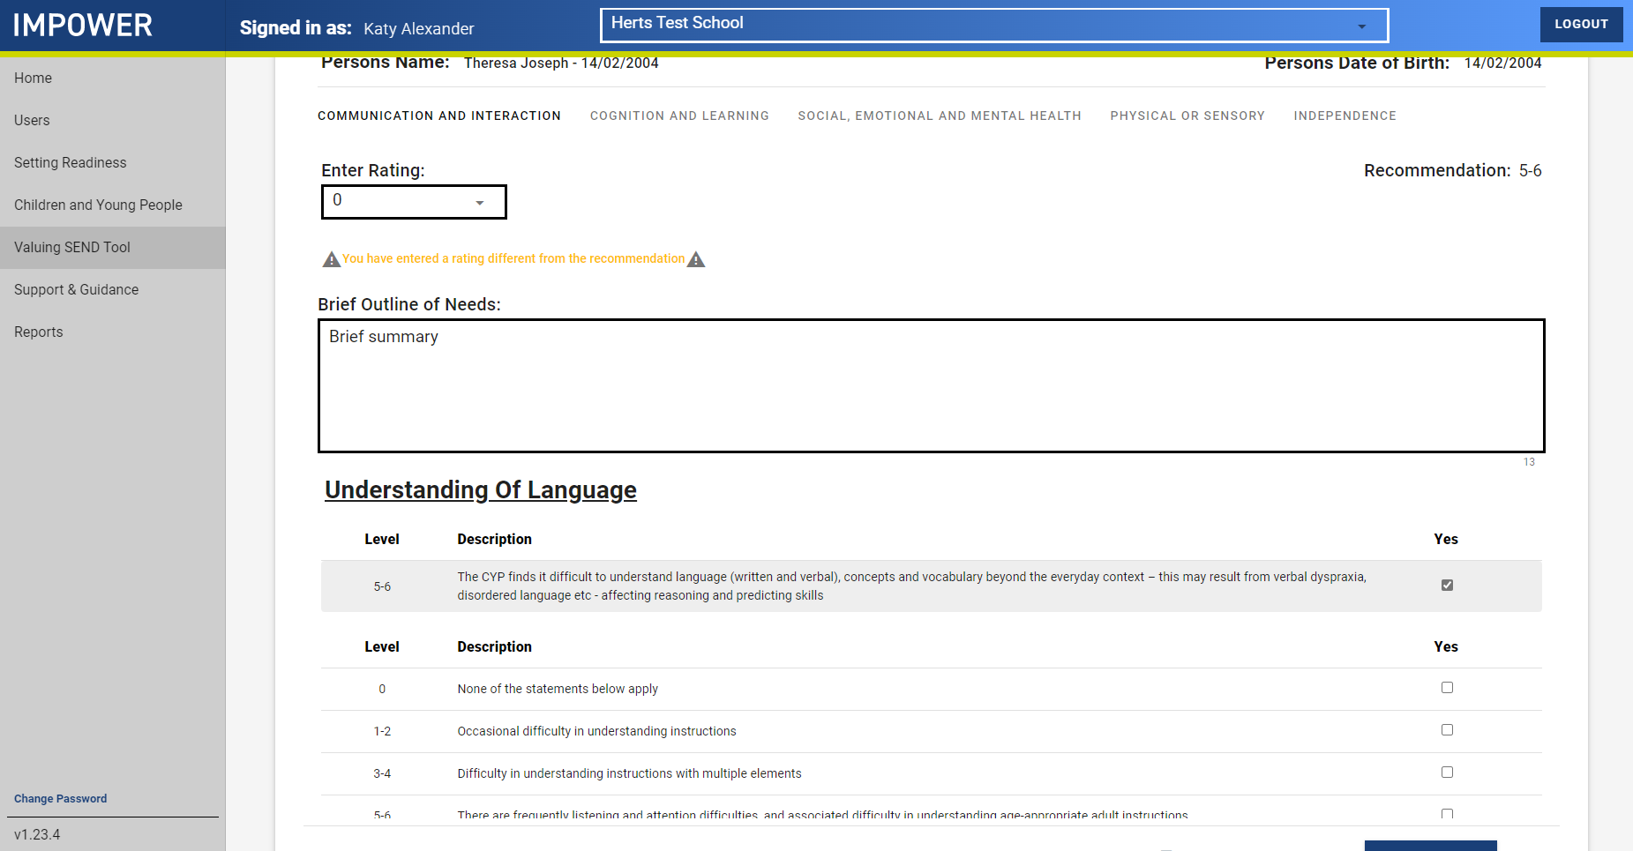
A look at the VSEND tool: CYP profiles
Once you have selected a rating, that prompt disappears and the next one is ready for you to assess the CYP
Notes:
SENDIAGO (Katy/Latoya/Sarah/Su)

Slide 20
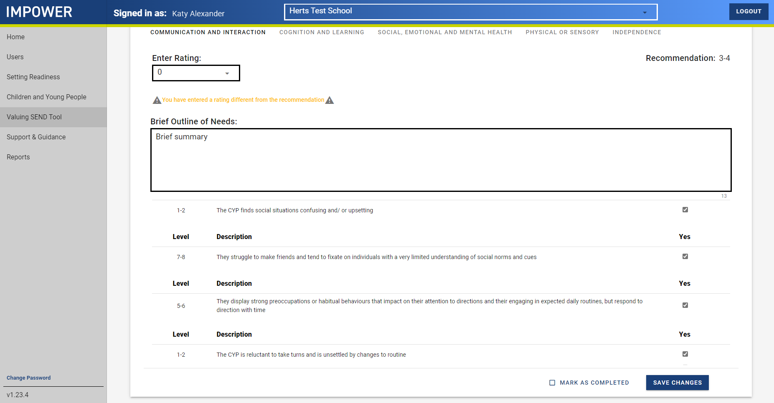
A look at the VSEND tool: CYP profiles
Click through each of the domains in turn, completing the assessments and providing ratings for the CYP
The tool uses your assessments to provide a recommended overall ‘best fit’ rating for each domain
When you finish, remember to click ‘Mark as completed’ and ‘Save changes’!
Notes:
SENDIAGO (Katy/Latoya/Sarah/Su)

Slide 21
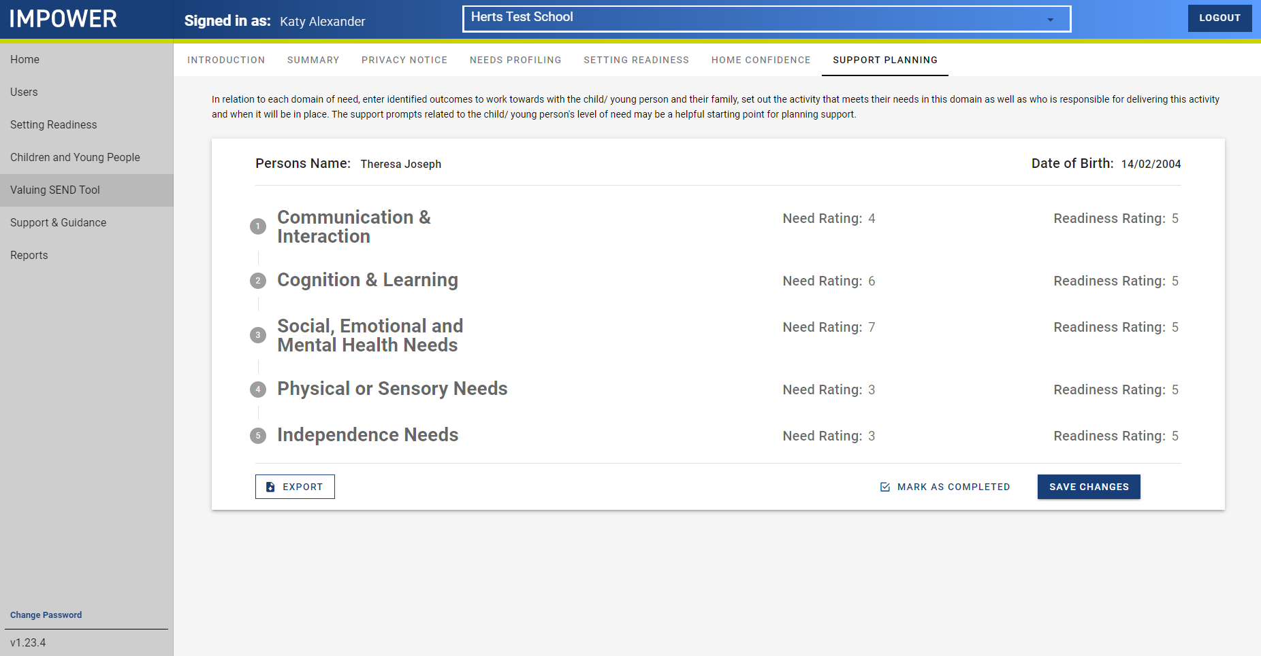
A look at the VSEND tool: Support Planning
This can be accessed once all the Needs Ratings and Setting Readiness Ratings are completed
Notes:
SENDIAGO (Katy/Latoya/Sarah/Su)
Support planning
Creates prompts and suggested strategies based on what has been inputted for each CYP
This can be shared with teachers, TAs, families
Can provide a basis for multi-disciplinary discussions, e.g. when calling advice lines or speaking with health professionals

Slide 22
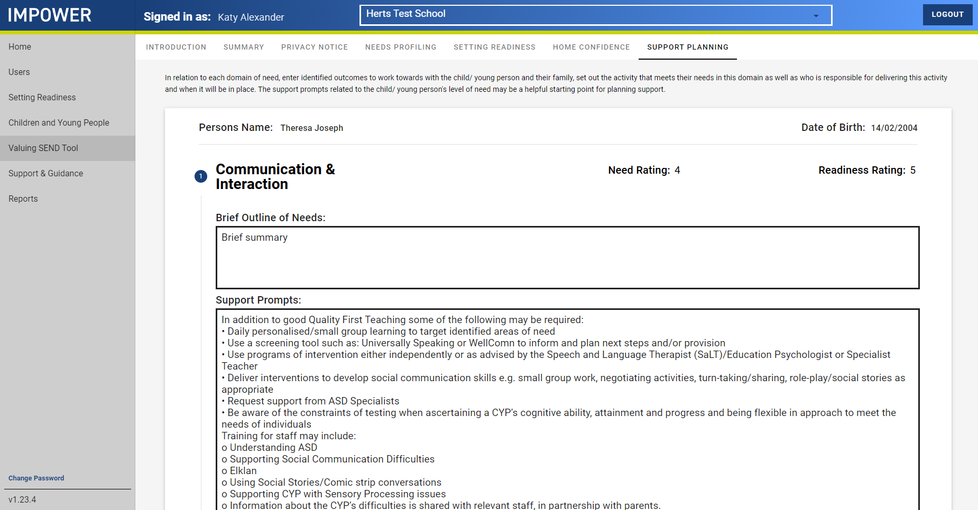
A look at the VSEND tool: Support Planning
This provides ideas for SENCOs to recommend, for class teachers to access independently and implement into their practice, and for any teachers or TAs involved in interventions to find ideas for strategies
This may also highlight where the SENCO (or other relevant staff) needs to deliver training, e.g. on how to use social stories
Note: there is no expectation that EVERY strategy will be implemented! This is a guide to be used alongside the SENCO’s professional judgement
Notes:
SENDIAGO (Katy/Latoya/Sarah/Su)

Slide 23
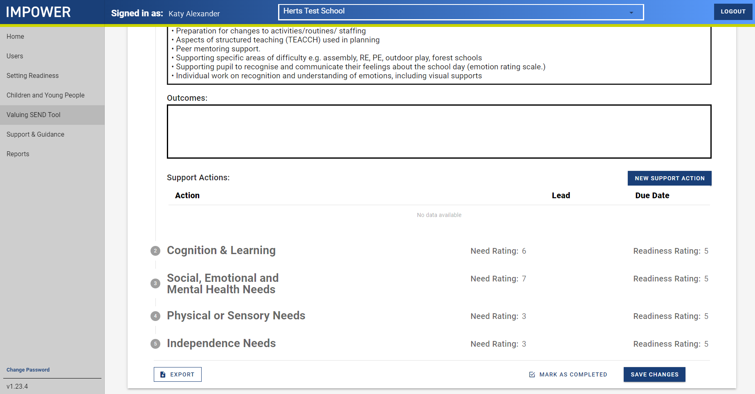
A look at the VSEND tool: Support Planning
Once the recommended strategies have been tried, the “Outcomes” box can be used to record any progress made (i.e. “Review” of APDR)
The next round of strategies can also be logged using the ‘New support action’ button (i.e. “Plan” of APDR)
Notes:
SENDIAGO (Katy/Latoya/Sarah/Su)

Slide 24
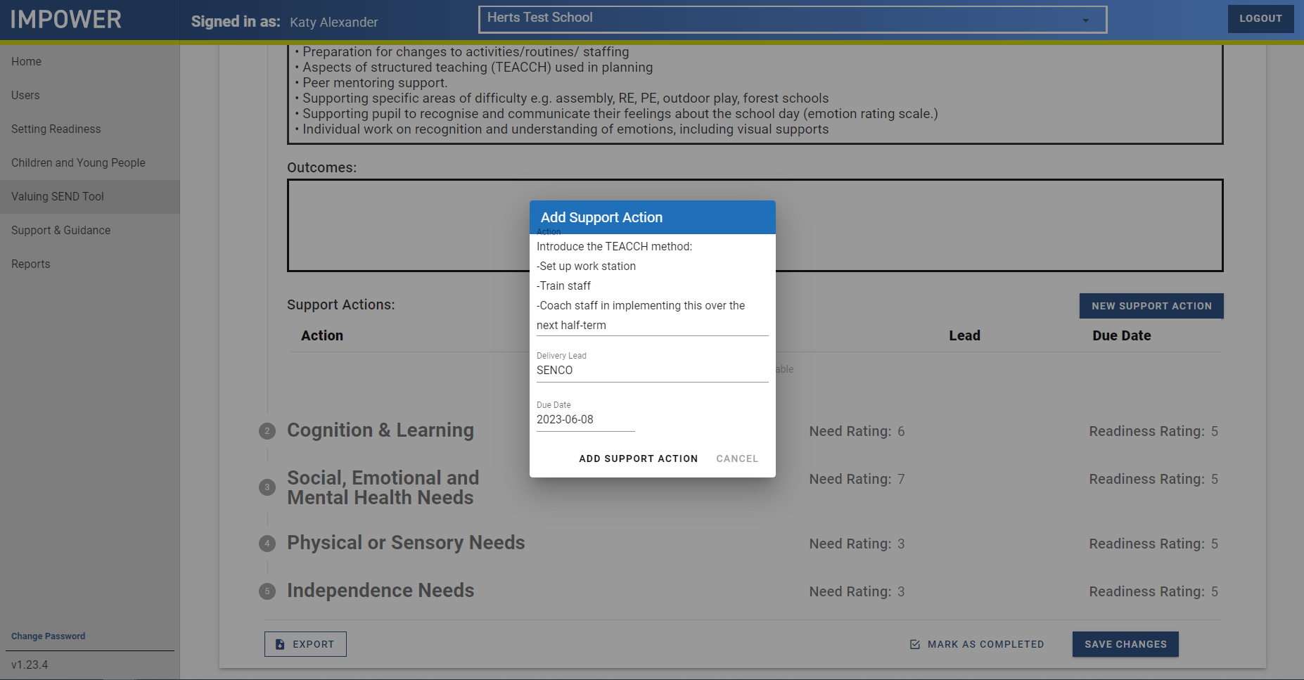
A look at the VSEND tool: Support Planning
This can be used as needed, including copying and pasting recommendations from Specialist Advisory Teachers
A review date can be added, if appropriate – i.e. when this strategy will be reviewed
Notes:
SENDIAGO (Katy/Latoya/Sarah/Su)

Slide 25

A look at the VSEND tool: Support Planning
All support actions appear like this, once entered
The support plan can be exported to PDF for printing and sharing as necessary, e.g. to share with Specialist Advisory Teachers, to put into CYP SEND files, for sharing with parents/carers etc
Notes:
SENDIAGO (Katy/Latoya/Sarah/Su)

Slide 26
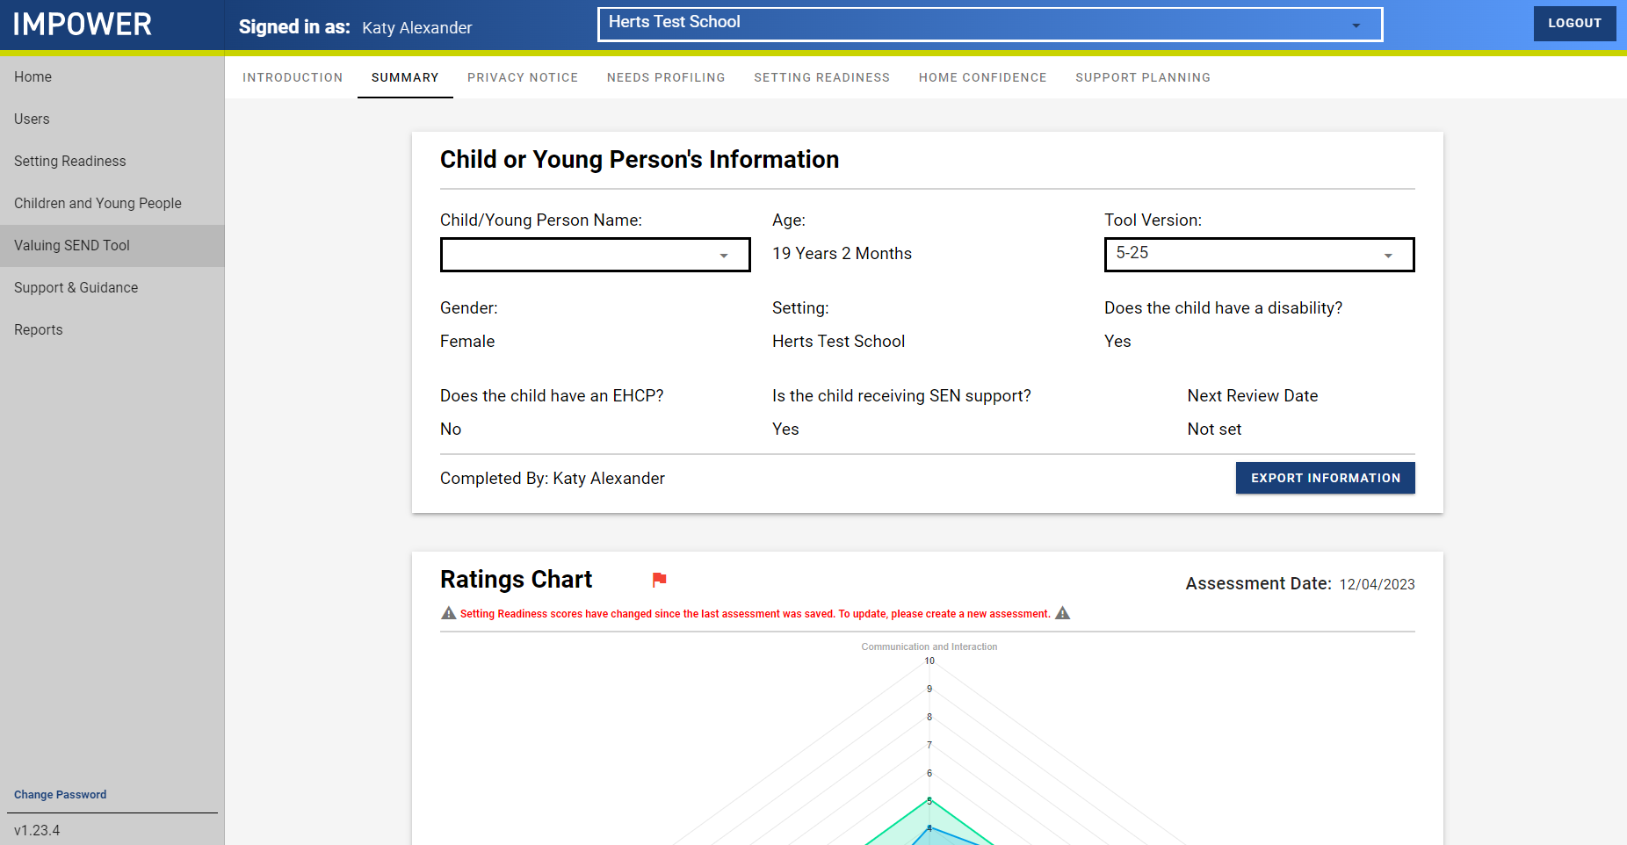
A look at the VSEND tool: Summary page
The summary page can also be exported to PDF
This includes the Ratings Chart, or ‘radar’
Notes:
SENDIAGO (Katy/Latoya/Sarah/Su)

Slide 27
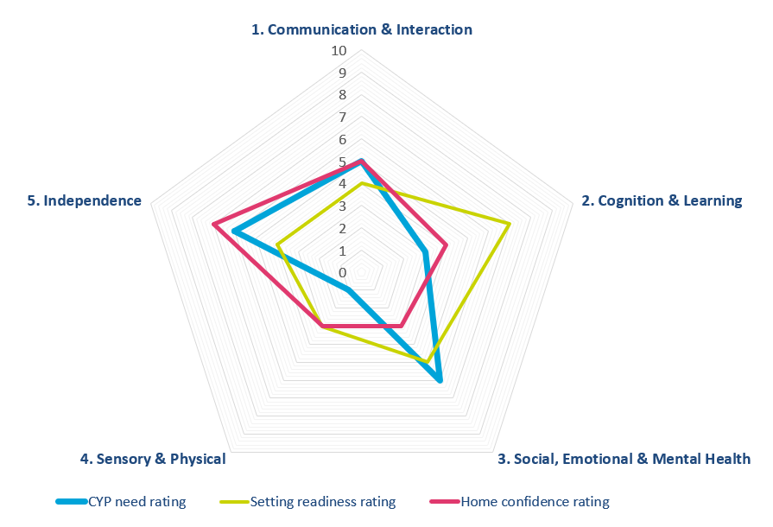
Valuing SEND | A clear and holistic view of the child or young person’s needs
The tool produces an ‘at a glance’ radar chart which maps:
A child or young person’s needs across 5 key domains
The readiness of the educational setting to meet needs across the 5 domains
The confidence of the home environment to meet needs across the 5 domains. Schools have found it helpful when parents have shared tools and techniques that work in the home with them to support their child’s in-school learning and vice-versa
Shows the ‘gaps’ between the child’s level of need and the setting readiness and home’s confidence to meet need at this point in time
Notes:
SENDIAGO (Katy/Latoya/Sarah/Su)
This is what the radar looks like
It has 5 axes, 0-10 from the centre
CYP need 0 = very little need in this domain / 10 = high need in this domain
Setting readiness 0 = no provision for this domain / 10 = highly specialist provision
Home confidence 0 = low confidence, no successful strategies / 10 = highly confident, lots of successful strategies

Slide 28
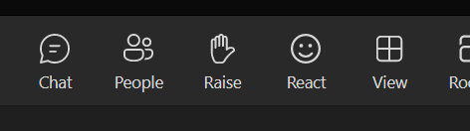
Q&A opportunity
Please use the “hands up” function and turn your microphone on when we get to your question
You are also welcome to stay on at the end of the session to discuss any queries with us!
Notes:
SENDIAGO and Champion answer any Qs together

Slide 29
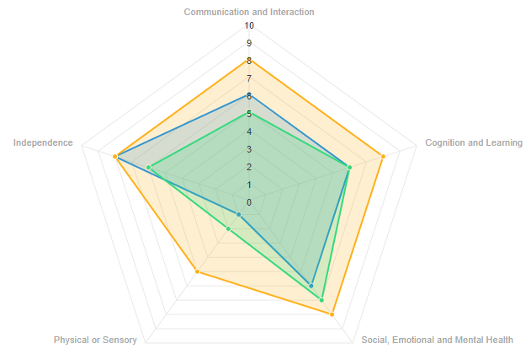
Valuing SEND | Case study example
Valuing SEND demonstrates where the setting could do more to meet the needs of Michael and parents/carers helped school finding new interventions to try.
CYP needs
Setting readiness
Home confidence
SITUATION – Michael is a 15-year-old with an EHCP. He has complex independence needs as well as significant needs in communication and interaction, cognition and learning and SEMH.
VALUING SEND – The radar shows that Michael’s needs are more significant, particularly in independence and cognition and learning, which surprised the SENCo and is higher than what the setting feels it currently provides.
ACTIONS / IMPACT – In the annual review, the SENCo went through VSEND with the parent/carer who was pleased and reassured to see all the interventions she had in place at home were suiting Michael’s needs well. School are now adopting new interventions specifically to suit Michael’s needs. The SENCo is also going to increase independence time for Michael to prepare him for transitioning.
Domains of Need | CYP needs | Setting readiness | Home confidence
1. Communication & Interaction | 6 | 5 | 8
2. Cognition & Learning | 6 | 6 | 8
3. Social, Emotional & Mental Health | 6 | 7 | 8
4. Sensory & Physical | 1 | 2 | 5
5. Independence | 8 | 6 | 8
“I worked with Michael’s link mentor and completed VSEND together to get a much more rounded picture of the child’s needs. I want to start using VSEND before having an annual review.” - SENCo
Notes:
Champion (e.g. DSPL Manager / SEND Lead)
Examples are from real schools in Hertfordshire
This was used for Michael’s AR, and threw up ideas for new strategies
Staff working with Michael had the opportunity to read through statements and offer a clearer rating than previously
Note: where needs meet exactly, there is no room for an increase in need
On average, we would anticipate mainstream schools rate themselves between 4-6 (maybe 7)
A reminder that the ratings are to inform practice – this is at the heart of the tool

Slide 30
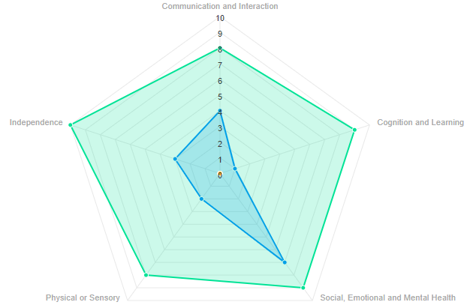
Valuing SEND | Case study example
Valuing SEND showed that Josef has complex SEMH needs and will need extra support as he transitions into a mainstream primary.
CYP needs
Setting readiness
SITUATION – Josef is a 4-year-old boy in a mainstream nursery. He is currently accessing some SEN support and does not have an EHCP. He has significant SEMH needs that have developed over the last year, as well as moderate communication and interaction needs, limited independence, cognition and learning and physical needs.
VALUING SEND – The tool helped to demonstrate that Josef’s needs are significant particularly in SEMH and will require further support as he transitions into a mainstream primary setting.
ACTIONS / IMPACT – The setting identified a good transition plan for Josef but thinks that specialist may be more suited to meet his needs. The setting plans to discuss the mainstream primary's setting readiness to be able to meet Josef’s need and start to plan more tailored support as he moves into year 1.
Domains of Need | CYP needs | Setting readiness
1. Communication & Interaction | 4 | 8
2. Cognition & Learning | 1 | 9
3. Social, Emotional & Mental Health | 7 | 9
4. Sensory & Physical | 2 | 8
5. Independence | 3 | 10
“Valuing SEND has not only highlighted needs, but also strengths in cognition and learning and VSEND helps confirm his complex SEMH needs.”
- Headteacher/SENCo
Notes:
Champion (e.g. DSPL Manager / SEND Lead)
Examples are from real schools in Hertfordshire
Completed to support transition from EYs setting to primary
The Nursey is working really well and has the right strategies, his needs are being met
On average, we would anticipate mainstream schools rate themselves between 4-6 (maybe 7)
A reminder that the ratings are to inform practice – this is at the heart of the tool

Slide 31

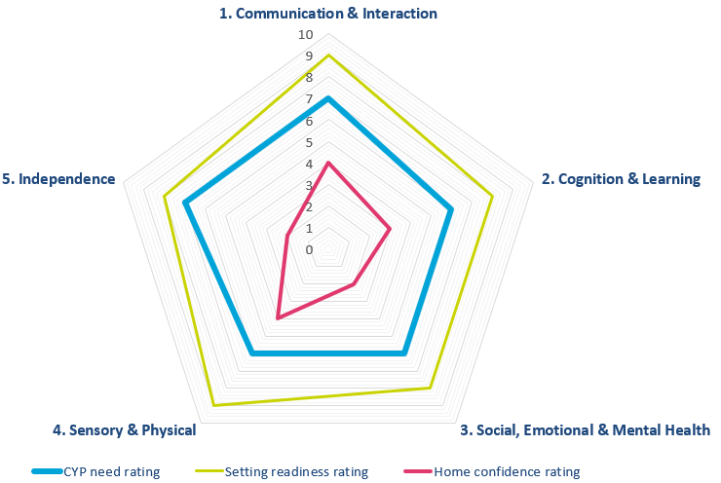
Valuing SEND | Activity
5 minutes
Scenario 1: ‘Ben’ is in Year 6 at a mainstream school.
Consider:
What does it tell us about the setting’s readiness to meet needs?
What does it tell us about the child/young person’s needs?
What does it tell us about the family’s confidence to meet needs at home?
Based on these insights, what key next steps or actions would you suggest?
Notes:
Champion (e.g. DSPL Manager / SEND Lead)
Background: this one used when parents expressed concern about the disparity between presentation at home and presentation at school; worried about transition to secondary school

Slide 32
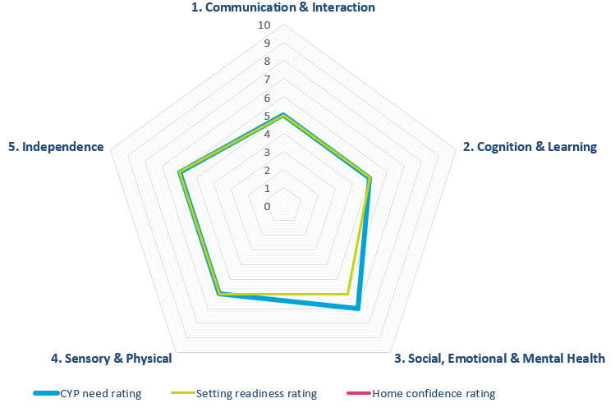
Valuing SEND | Activity
5 minutes
Scenario 2: ‘Oscar’ is in Early Years mainstream provision.
Consider:
What does it tell us about the setting’s readiness to meet needs?
What does it tell us about the child/young person’s needs?
Based on these insights, what key next steps or actions would you suggest?
Notes:
Champion (e.g. DSPL Manager / SEND Lead)
Setting was looking at their own provision in terms of Oscar’s needs; had discussed with family but not yet had that more in-depth discussion around Home Confidence
NB most points are meeting his needs exactly – future-proof?

Slide 33

Valuing SEND | How and when to use it
The Valuing SEND tool has been designed for use for any child or young person with additional needs, from birth through to age 25.
Graduated response to supporting children & young people
Regularly review need and support to ensure the support is working for the child or young person
PLAN
DO
Use the tool to ensure the right support is provided early
Support is planned
Needs are monitored
Use the tool to support phased transfer (e.g. primary to secondary school)
ASSESS
REVIEW
Needs are identified
Support is reviewed
Support is planned in a new setting
Use the tool to identify needs early
Consistent use of this tool will allow a clear picture of how needs change over time, both for the individual child or young person, and for the setting as a whole.
Notes:
SENDIAGO (Katy/Latoya/Sarah/Su)
Can use for the entire APDR process, and use it as your evidencing tool

Slide 34
Valuing SEND | How and when to use it
For a CYP with emerging needs – for you to track over time and see whether they have SEND
To support the coaching of staff, e.g. for support plans, department CPD, for a particular cohort of pupils
To facilitate discussion with a parent who believes their child should have an EHCP
For transition between settings, e.g. from PVI to primary or from primary to secondary
For support staff to log and track the intervention/s they are using with an individual (or a group)
To track and provide evidence for a CYP to be used with advisory teachers, for LHNF, for provision panel, or as part of a request for an EHCNA
To produce data, evidence, reports and case studies for governors, inspectors, staff teams, parents/carers etc
As your setting’s Assess, Plan, Do, Review tracker, to be used and updated in termly APDR meetings between parents/carers, SENCO and teachers
Notes:
SENDIAGO (Katy/Latoya/Sarah/Su)
Some of the ways schools have used VSEND
Not an exhaustive list, nor is it instructional ☺

Slide 35


Aligning use of Valuing SEND and the Descriptors of Need (provision document)
Valuing SEND and Hertfordshire’s new provision document should be used together. The vision is for settings to be able to evidence how they have done this when applying for specialist support.
Understand needs…
…explore support options
Valuing SEND is completed and reviewed to…
Identify strengths as well as any potential gaps in support
Support a collaborative discussion between the setting, family and any other professionals about where different approaches may be needed to meet needs
Once potential gaps in provision have been identified, the provision document is consulted to…
Ensure a range of options have been considered to better support needs
Inform a discussion about how alternative approaches will address the gaps highlighted by the VSEND tool, and when and how this will be assessed
Notes:
SENDIAGO (Katy/Latoya/Sarah/Su)
The ways in which VSEND and the provision document complement each other

Slide 36
Valuing SEND | A co-ordinated approach
The vision: for VSEND to be consistently embedded in LA decision-making processes
Benchmarking tool for whole-school action planning
Goal-based outcomes using VSEND to input and track
Referral to specialist services using VSEND evidence
VSEND tool to track individuals against setting readiness
Descriptors of Need to analyse need and the most appropriate provision
Use as a basis for discussion when calling services like Ask SALI
Notes:
SENDIAGO (Katy/Latoya/Sarah/Su)
Lots of tools available in Hertfordsire!
The vision is at the centre – you can use VSEND as the thing sitting in the middle of all these
A look at how the other tools are all different, and how they work together as a suite

Slide 37
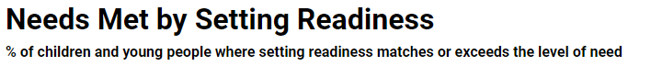
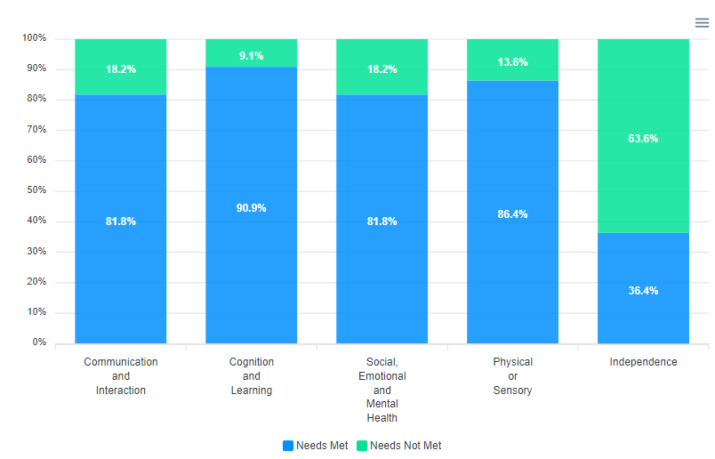
Valuing SEND | Reports
On the reports page, you can generate a report with Valuing SEND findings from your particular setting.
The charts show a rating chart, overview of needs, need met by setting readiness and home confidence.
These highlight where needs are within your setting (in this example, you can see that independence is where the setting could focus on to meet needs).
These charts can be used by you and your colleagues to talk through VSEND, understanding where there are gaps in provision and where families might need more support.
Notes:
SENDIAGO (Katy/Latoya/Sarah/Su)

Slide 38

Valuing SEND | The bigger picture
LA locality level
When Valuing SEND is being used on a large scale, by all schools and settings within a locality, it can be used for strategic commissioning.
We hope that the widespread use of Valuing SEND can:
Map needs across Hertfordshire and within DSPLs
Provide evidence for commissioning services to DSPLs, based on an accurate picture of needs that exists within a geographical area
Identify future peaks in demand, e.g. requests for statutory assessment, to help HCC plan and prepare delivery
Identify best practice and facilitate school-to-school support
Notes:
Champion (e.g. DSPL Manager / SEND Lead)
This is where we would like to be in a few years’ time!
Lots of this is already happening in one way or another – it’s hoped VSEND will allow consistency of approach

Slide 39
Further Support | Resources
After this Valuing SEND training, you will receive the slides from the training and a link to the Grid page containing Valuing SEND resources that have been developed to support those completing the Valuing SEND digital tool. The resources include the following:
Step-by-step guide to completing the Valuing SEND Digital Tool
Instructional videos on completing the Valuing SEND Digital Tool
Training slides and printable document with domain prompts
VSEND Page on the Grid: https://thegrid.org.uk/send-and-additional-needs/hertfordshire-valuing-send-training-vsend
Notes:
SENDIAGO (Katy/Latoya/Sarah/Su)

Slide 40
Bear in mind…
VSEND is new to everyone – we’re in the rollout stage! We are here to help and your SISOs are keen to learn how to use it too
The tool itself can be tweaked and updated based on feedback. Send us your thoughts, solutions and ideas for improvement as we have regular feedback points with Unify
VSEND is the expected approach, it is not a statutory tool. Like Herts Steps, if you choose not to use VSEND, you are expected to have something that will provide evidence as clearly – we are seeking consistency
Notes:
SENDIAGO (Katy/Latoya/Sarah/Su)

Slide 41

Valuing SEND | Next steps
  Training is great, but it is easy to forget, so we encourage you to maintain the momentum. Once you receive your login details, have a play with the system and complete your setting readiness. We recommend doing this with your SLT.
  Have a conversation with your staff team to decide which 3 children you might initially be able to use the approach with.
  Remember – VSEND is great for supporting you with problem solving!
Contact details:
If you have any questions or queries please contact vsend@hertfordshire.gov.uk and for any technical issues after receiving your login please contact the Unify helpdesk at support@unifybusiness.co.uk
Your login to VSEND should be available a week after attending training
Notes:
SENDIAGO (Katy/Latoya/Sarah/Su)

