Slide 1
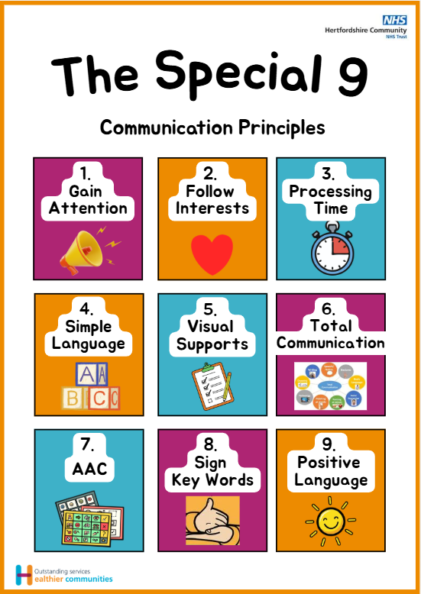
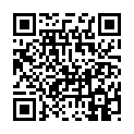
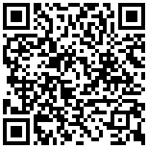
Follow the links below for further resources and advice
Watch our FREE webinar on
The Special 9
Scan this QR code to access The Special 9 poster to display at your setting:
You can also visit the service webpage:
www.hct.nhs.uk/CYPT-SALT
Turn over to find out more!
Follow these 9 principles to create
a communication friendly environment
in your setting
HCT Children & Young People’s Therapies Service
Notes:
Look inside to find resources, webinars and advice on supporting…
Supporting children and young people to….
?noticing adults in play/ noticing adults in play?
Accessing learning and managing change
(Developing) friendships
(Social) communication
Language (development)
Conversations
Social communication for children / young people beginning to use words
Social communication for children / young people using phrases
Social communication for children/ young people beginning to have conversations

Slide 2
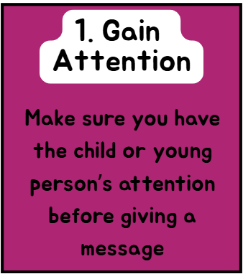
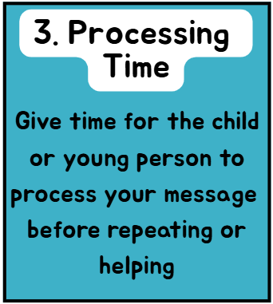
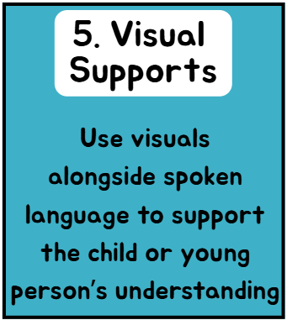
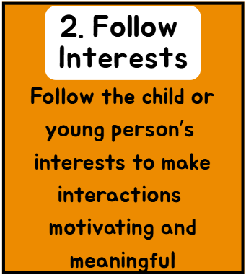
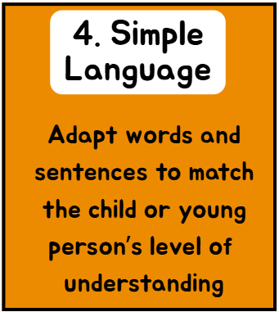
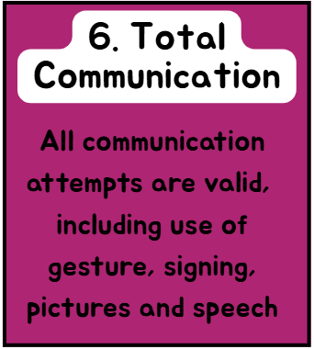
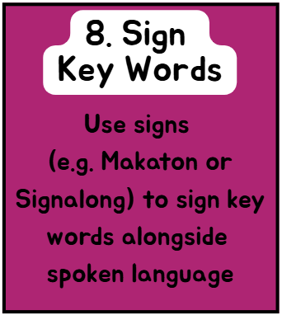


The Special 9 communication principles
HCT Children & Young People’s Therapies Service
Notes:
Look inside to find resources, webinars and advice on supporting…
Supporting children and young people to….
?noticing adults in play/ noticing adults in play?
Accessing learning and managing change
(Developing) friendships
(Social) communication
Language (development)
Conversations
Social communication for children / young people beginning to use words
Social communication for children / young people using phrases
Social communication for children/ young people beginning to have conversations

